Slide 1



The Students’ Guide to
Microsoft Teams

Slide 2
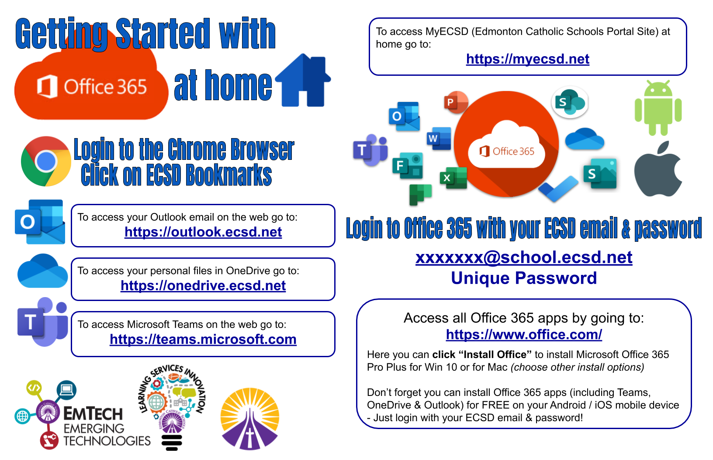

Slide 3
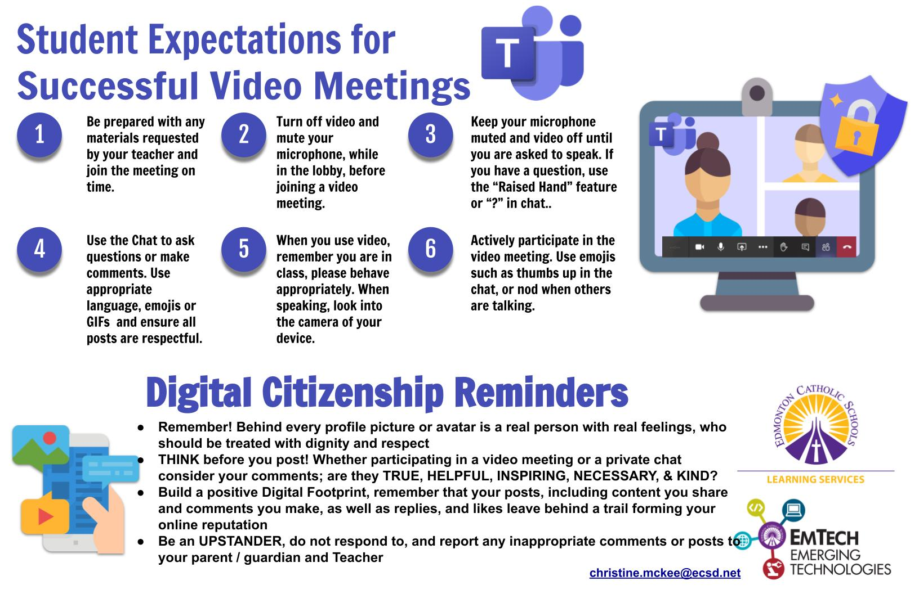

Slide 4

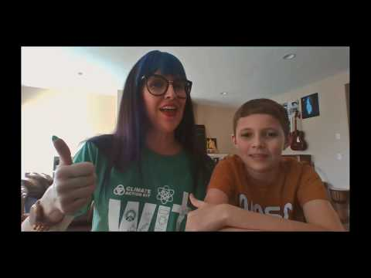

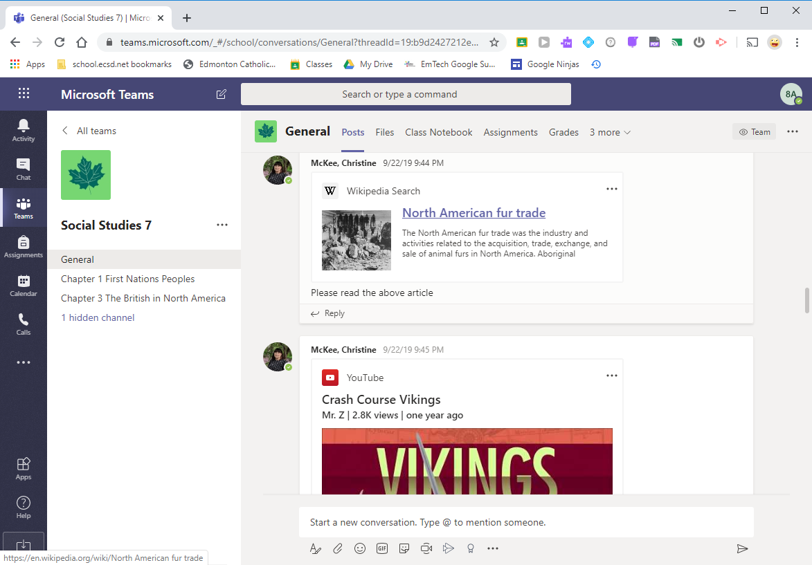
Step 1: Login to the Chrome Browser (or Your Chromebook)

Slide 5
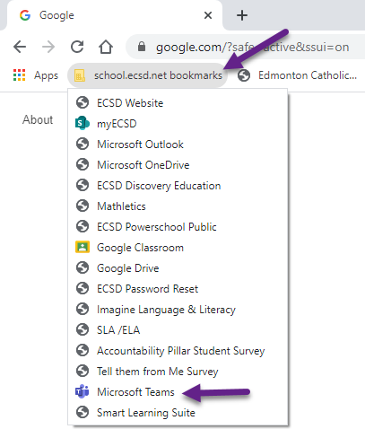
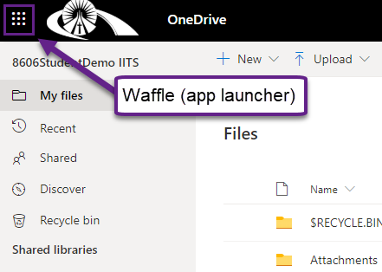
Accessing MS Teams
To access MS Teams as a student, first login to the Chrome browser on your computer with your ECSD email and password:
xxxxxxx@school.ecsd.net
Unique password
Click on ECSD Bookmarks bar and navigate to Microsoft Teams.
-OR-
If you are in an Office 365 app (Outlook or OneDrive), click on the waffle (app launcher) in the top left corner and navigate to Microsoft Teams

Slide 6
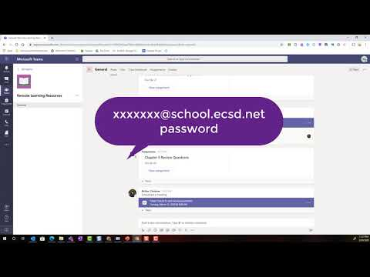
Step 2: Accessing MS Teams

Slide 7
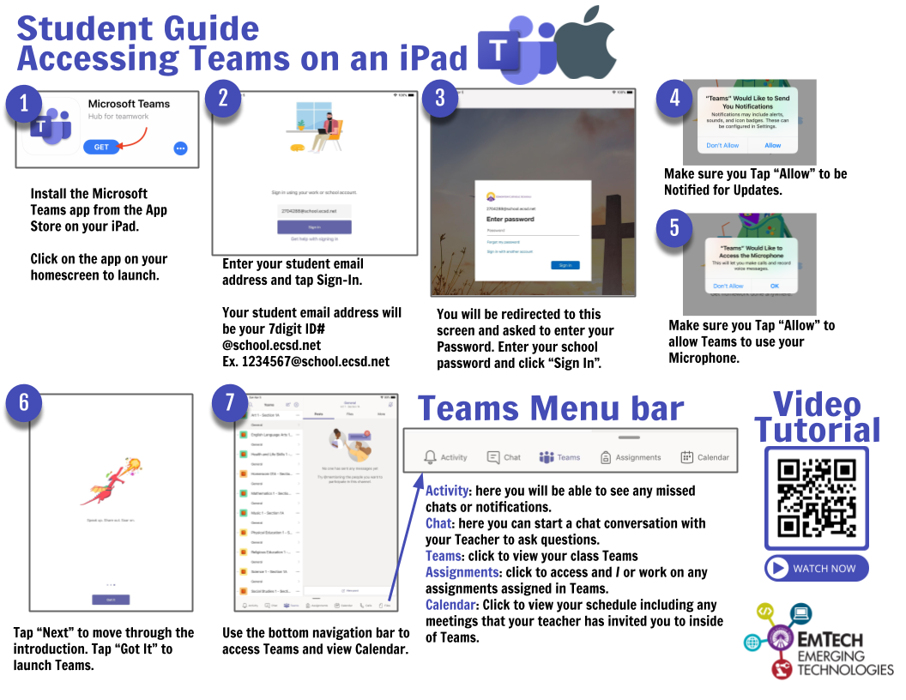

Slide 8

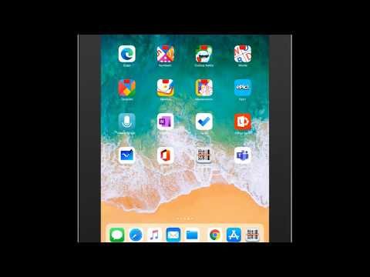

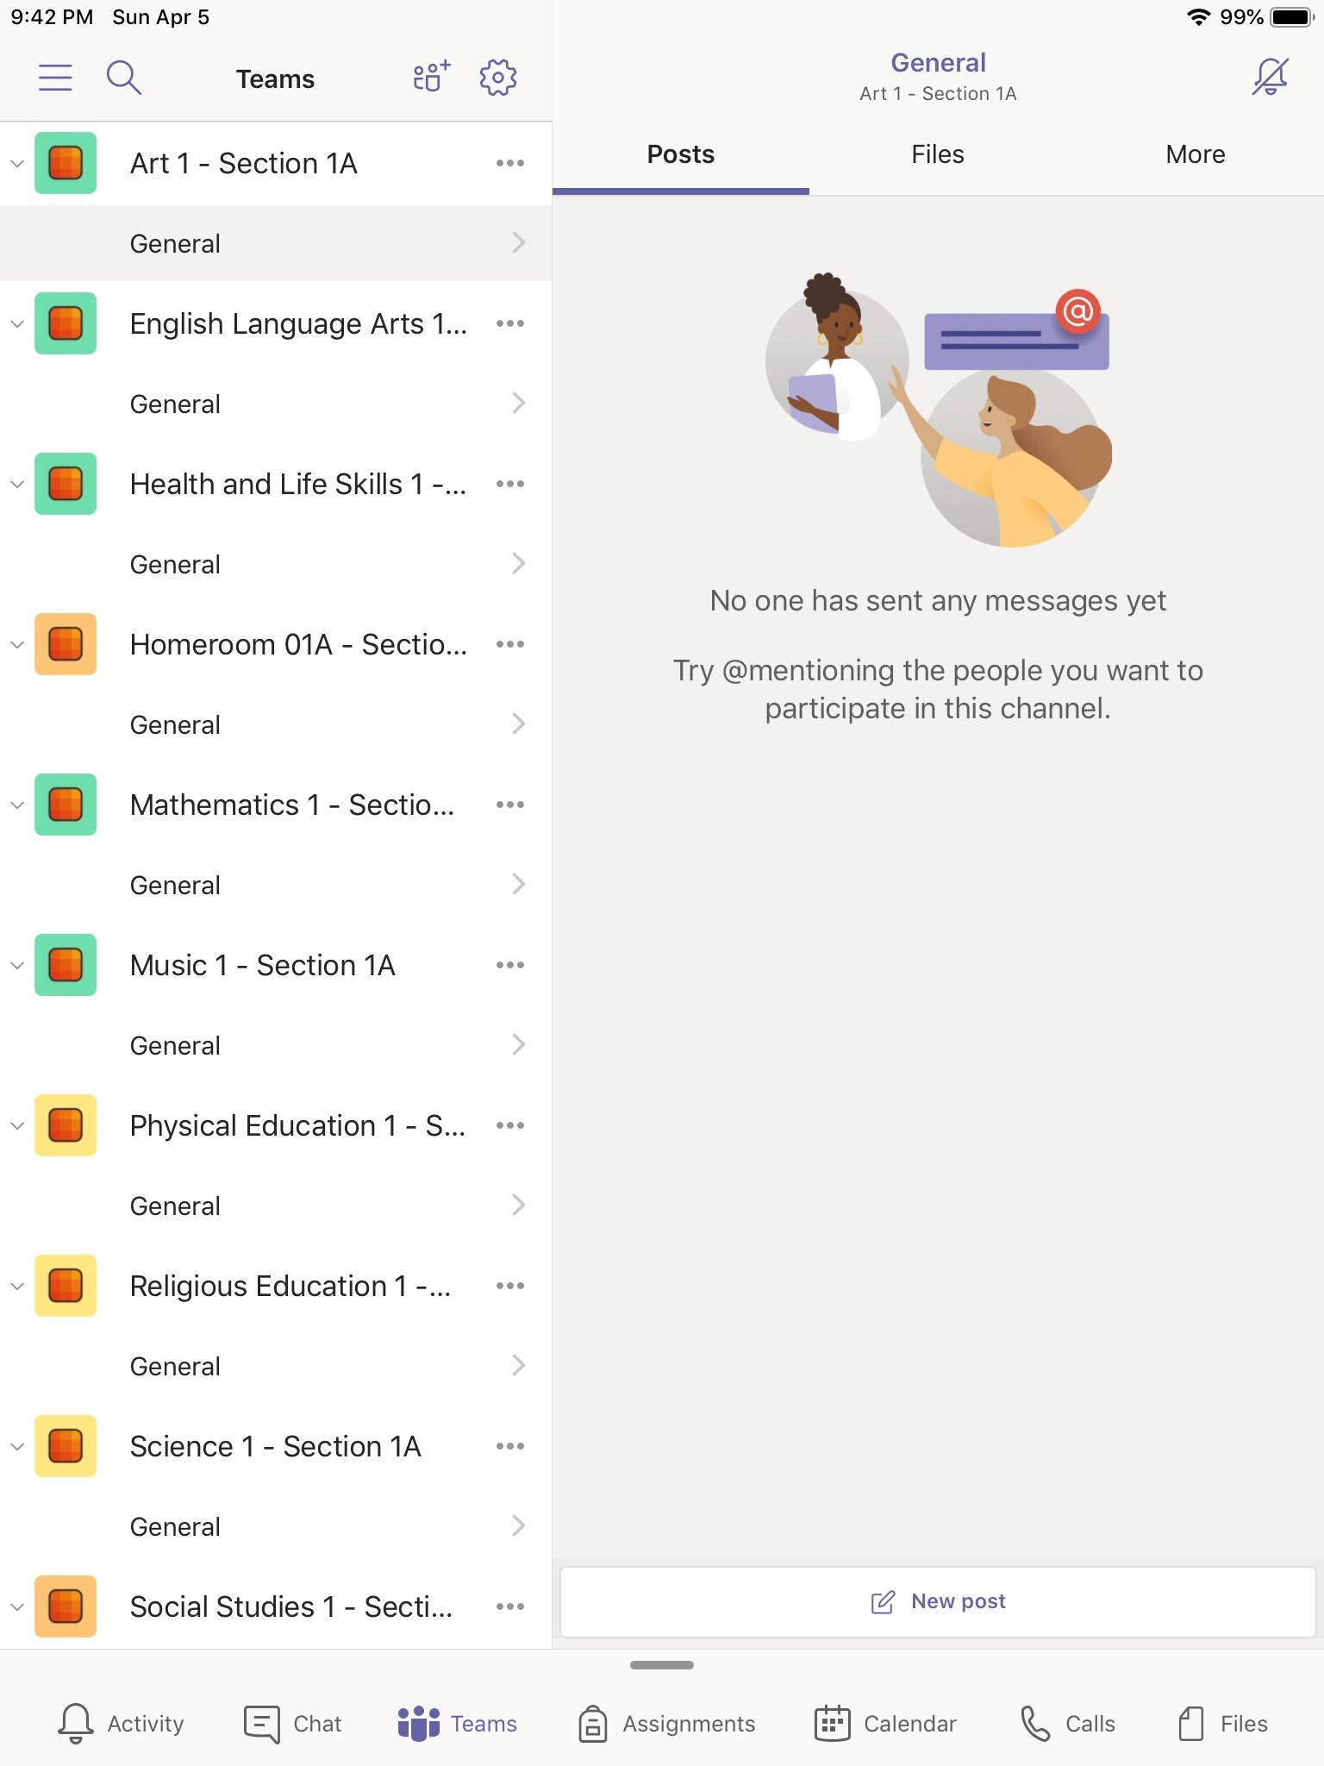

Accessing Microsoft Teams on an iPad!

Slide 9
What is Microsoft Teams?
Microsoft Teams (MS Teams) is your child’s digital center for learning.
Teachers use MS Teams to share assignments, homework, post announcements, host class discussions, interact with students through video conferencing, and possibly communicate with parents.

Slide 10
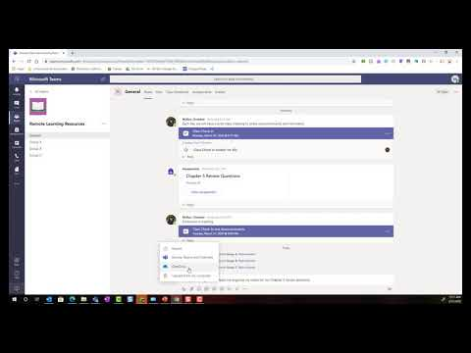
Overview of MS Teams for Students and Parents

Slide 11
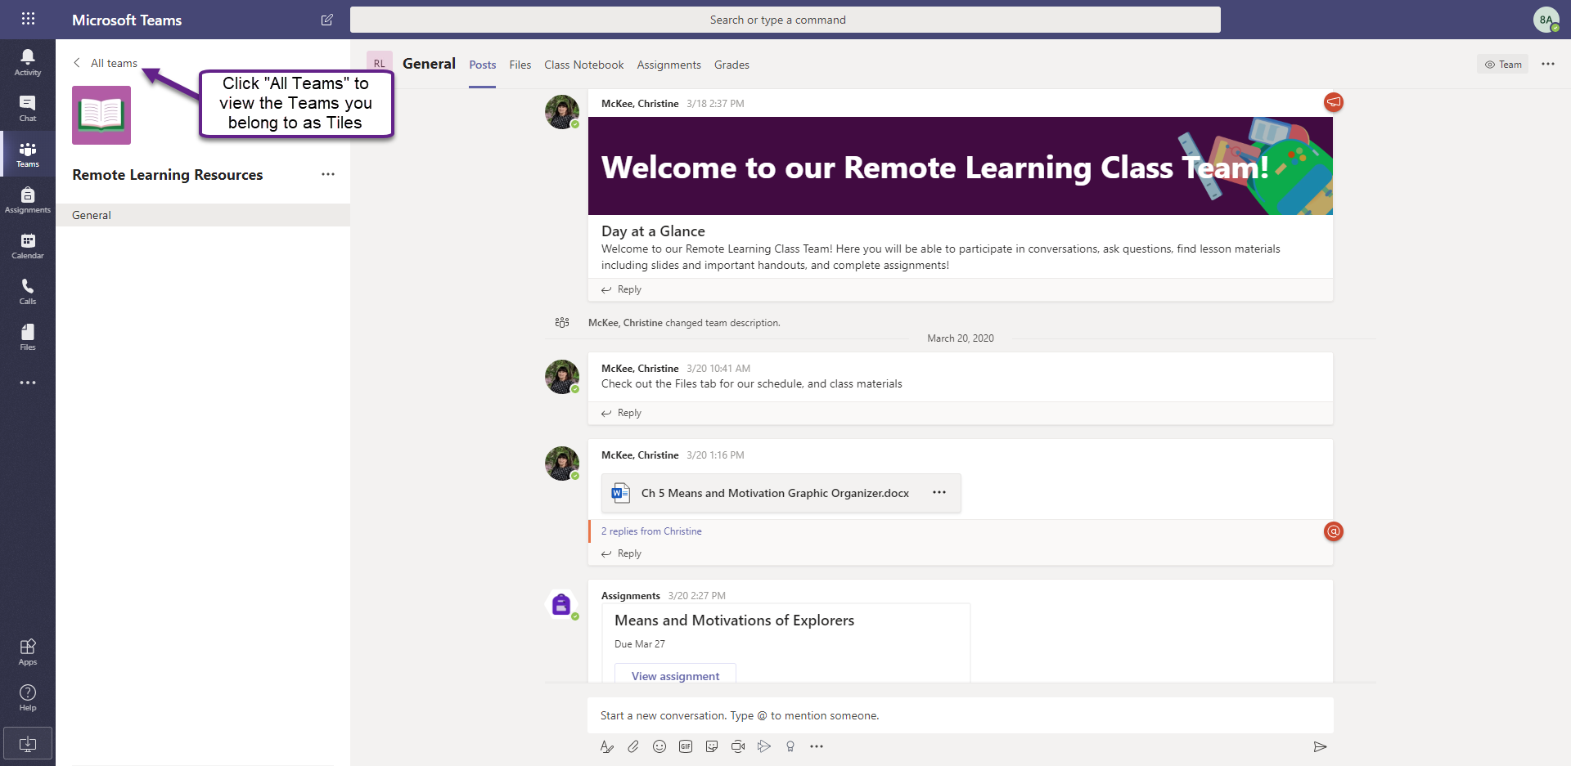
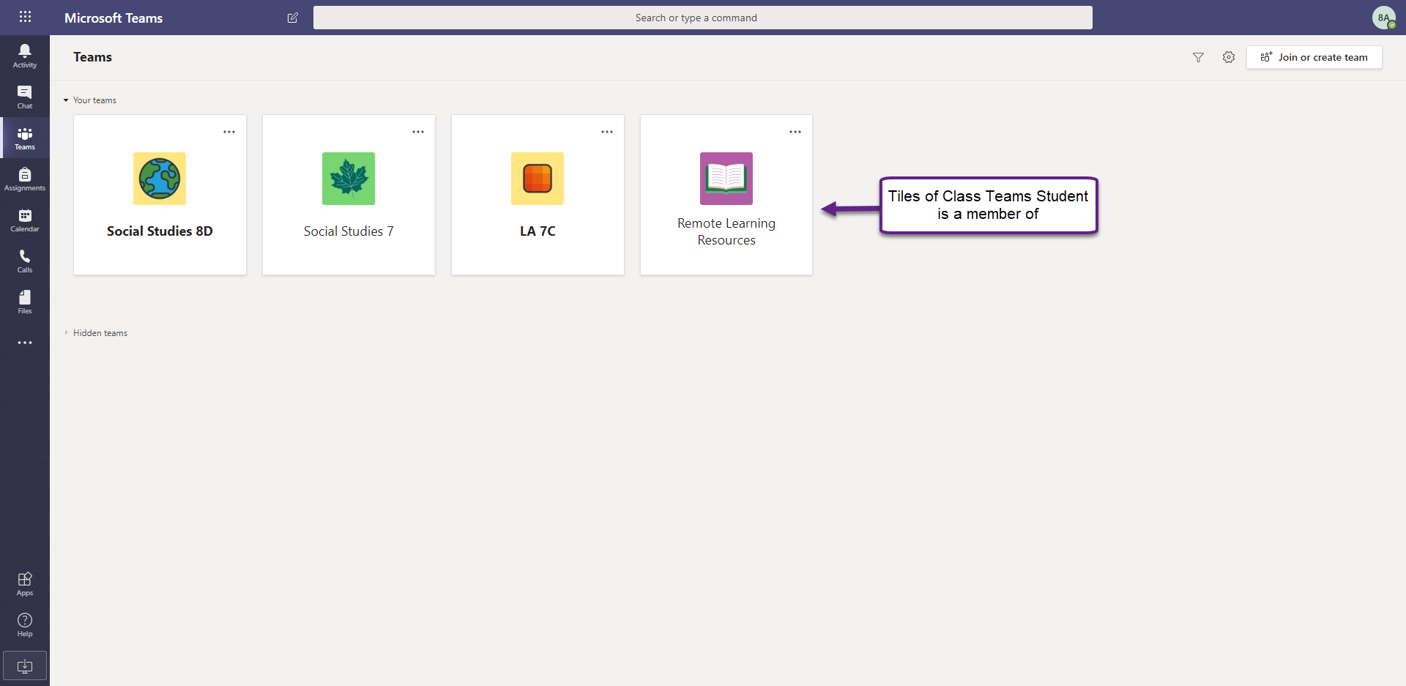
Accessing a Class Team You are a Member of…
If your Teacher is using the Class Team(s) that you have already been added to as a member, you will see the class Team tile(s) in your view of all Teams. Click on the class Team you wish to work in.

Slide 12
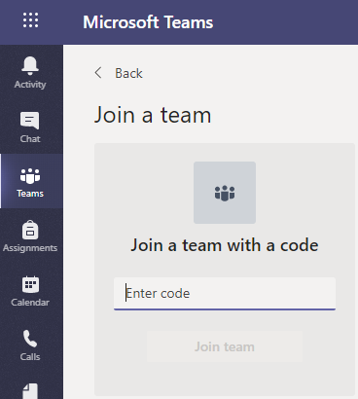
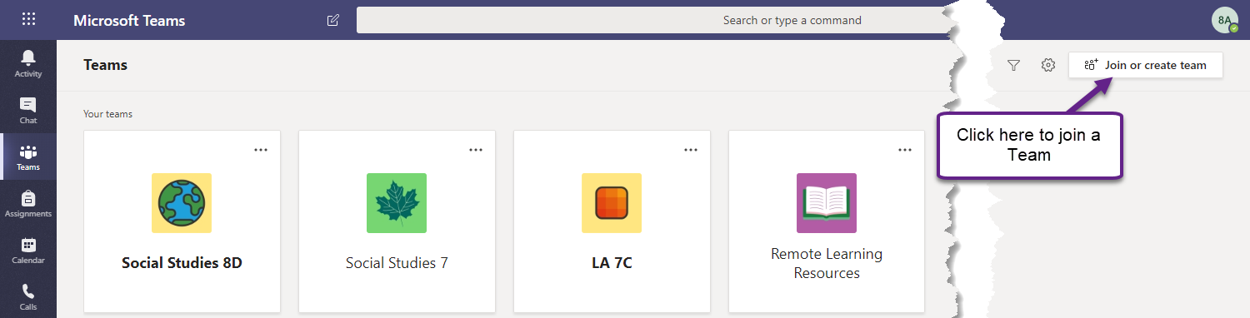
Joining a Class Team with a Code…
Your teacher may invite you into a class Team with a Join Code. To join a Team, make sure you are in “All Teams,” view and click the “Join or Create Team” button.
Enter the join code your teacher has shared with you.

Slide 13
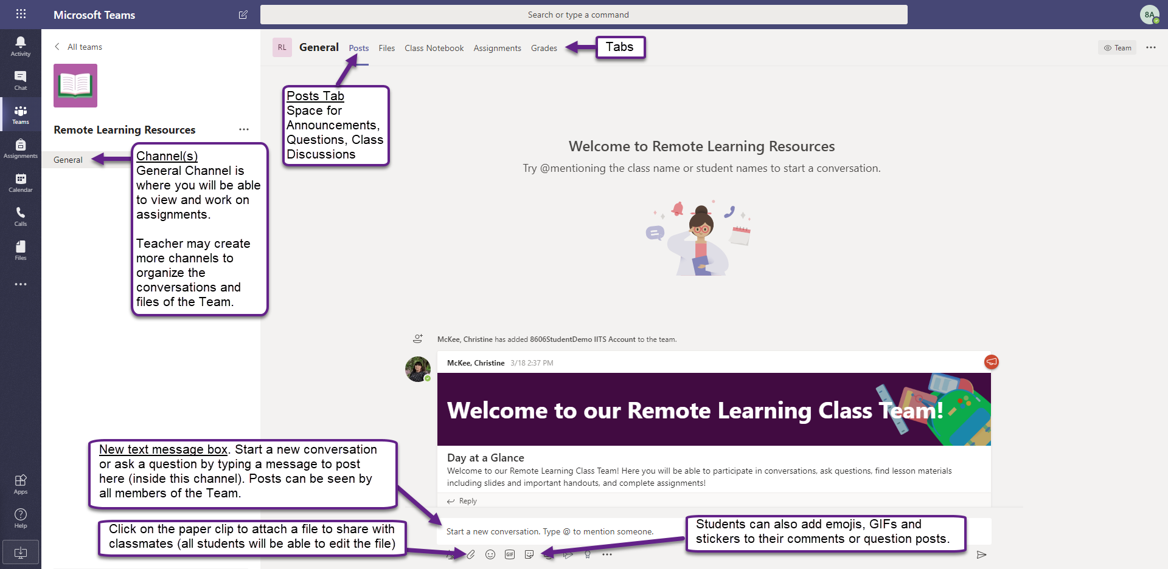
Inside a Class Team: Working in the Posts Tab

Slide 14
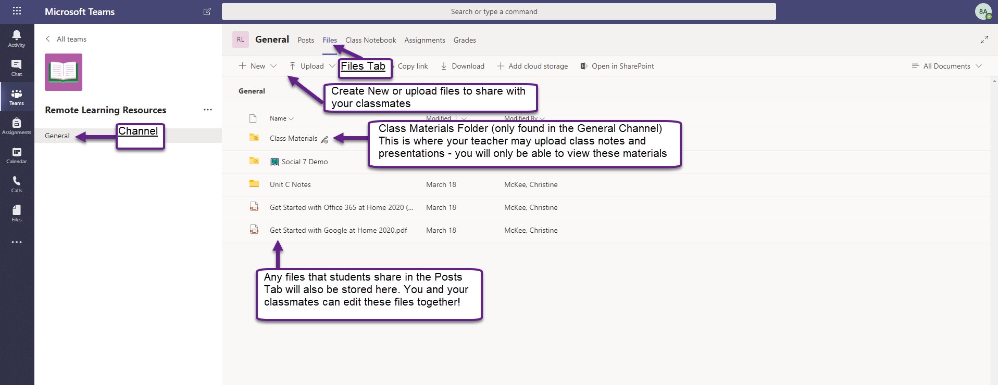
Inside a Class Team: Accessing and Sharing Content Inside the Files Tab

Slide 15
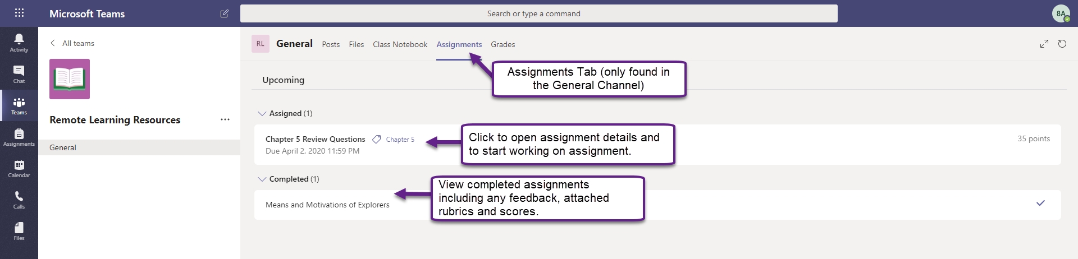
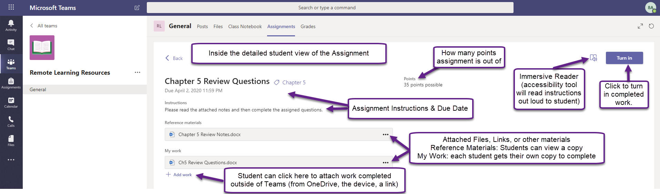
Inside a Class Team: Viewing Assignments
Viewing the details of an assignment (2)

Slide 16
Inside a Class Team: Viewing Assignments
Viewing the details of an assignment

Slide 17


Access MS Teams ANYTIME, ANYWHERE
You can also get the Microsoft Teams app for your iOS or Android device (phone or tablet) from the App Store or Google Play Store for FREE.
Once you install the app on your device, login to the MS Teams app with your ECSD email and password:
xxxxxxx@school.ecsd.net
Unique password

